Slide 1

JS Design Patterns
Following Best Practices
SoftUni Team
Technical Trainers
Software University
https://softuni.bg

Slide 2
Table of Contents
What is a Pattern?
Common Design Patterns
Factory pattern
Decorator pattern
Observer Pattern

Slide 3

Definition and Structure
Design Patterns

Slide 4
What is a Pattern?
Recurring solutions to design problems you see over and over
Constitute a set of rules describing how to accomplish certain tasks
Design patterns focus more on reuse of recurring architectural design themes
Frameworks focus on detailed design and implementation

Slide 5
Categories of Design Patterns
Design Patterns can be broken down into a number of different categories:
Creational
Structural
Behavioral

Slide 6
Creational Design Patterns
Focus on handling object creation mechanisms
These patterns control the creation problems
Some of the patterns that fall under this category are:
Constructor
Factory
Prototype
Singleton

Slide 7
Structural Design Patterns
Focus on object composition
Ensure that when one part of a system changes, the entire structure of the system doesn't need to do the same
Some of the patterns that fall under this category are:
Decorator
Facade
Adapter
Proxy

Slide 8
Behavioral Design Patterns
Focus on improving or streamlining the communication between disparate objects in a system
Some of the patterns that fall under this category are:
Iterator
Mediator
Observer
Visitor

Slide 9
Benefits of Design Patterns
Inspiration
Patterns don't provide solutions, they inspire solutions
Patterns explicitly capture expert knowledge and design tradeoffs
Patterns improve communication
Pattern names form a vocabulary
Design patterns enable large-scale reuse of software architectures

Slide 10
Drawbacks of Design Patterns
Patterns do not lead to direct code reuse
Patterns are deceptively simple
Teams may suffer from patterns overload
Integrating patterns into a software development process is a human-intensive activity

Slide 11

Factory Pattern

Slide 12
The Factory Pattern
Main purpose - creation of objects
Use when
a class can't anticipate the class of objects it must create
a class wants its subclasses to specify the objects it creates
classes delegate responsibility to one of several helper subclasses

Slide 13
Pros and Cons
Pros
Compatible products
You avoid tight coupling
Single Responsibility Principle
Open/Closed Principle
Cons
The code may become more complicated than it should be

Slide 14
Example
function Employee(name) {
this.name = name;
this.say = function () {
console.log(`I am ${name}`)
};
}
function EmployeeFactory() {
this.create = function (name) {
return new Employee(name);
};
}
let employeeFactory = new EmployeeFactory();

Slide 15
Example (2)
let people = [];
let employeeFactory = new EmployeeFactory();
people.push(employeeFactory.create("Joan Peterson"));
people.push(employeeFactory.create("Tim O'Neill"));
people.forEach((person) => {
person.say();
})

Slide 16

Decorator Pattern

Slide 17
The Decorator Pattern
Lets you attach new behaviors to objects
Uses
For adding responsibilities to individual objects dynamically and transparently
For responsibilities that can be withdrawn
When extension by subclassing is impractical

Slide 18
Pros and Cons
Pros
Alternative to subclassing for extending functionality
Supports the principle that classes should be open for extension but closed for modification
Cons
Many small objects in our design
Can cause issues if the client relies heavily on the components concrete type
Can complicate the process of instantiating the component

Slide 19
Example
let User = function (name) {
this.name = name;
this.say = function () { console.log("User: " + this.name); };
}
let DecoratedUser = function (user, city) {
this.user = user;
this.name = user.name; // ensures interface stays the same
this.city = city;
this.say = function () {
console.log(`Decorated User: ${this.name}, ${this.city}`)
};
}
//Continues on the next slide

Slide 20
Example
let user = new User("Kelly");
user.say();
let decorated = new DecoratedUser(user, "New York");
decorated.say();
User: Kelly
Decorated User: Kelly, New York

Slide 21

Facade Pattern

Slide 22
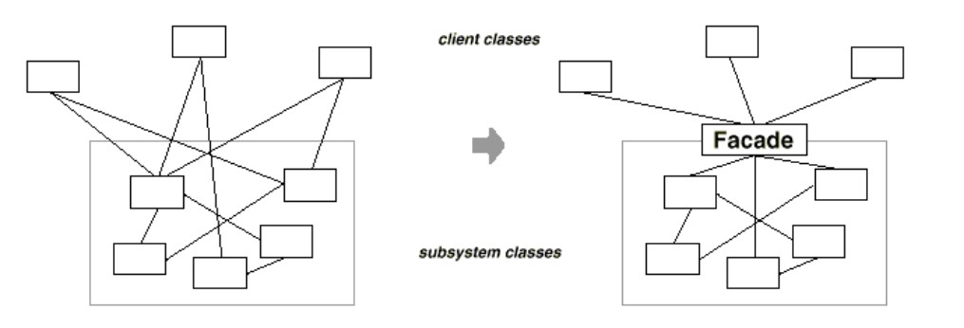
The Facade Patters
Widely used in the JavaScript libraries
Provides an interface which shields clients from complex functionality in one or more subsystems

Slide 23
Pros and Cons
Pros
You can isolate your code from the complexity of a subsystem
Cons
facade can become a god object coupled to all classes of an app

Slide 24
Example
class ComplaintRegistry {
registerComplaint(customer, type, details) {
let registry;
if (type === 'service') {
registry = new ServiceComplaints();
} else {
registry = new ProductComplaints();
}
return registry.addComplaint({ id, customer, details });
}
}

Slide 25

Observer Pattern

Slide 26
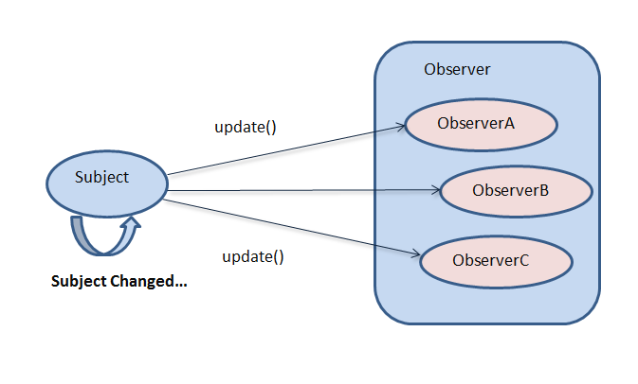
Common Participants
Subject – an object, maintains observers, can suggest the addition or removal of observers
Observer - provides an update interface for objects that need to be notified of a Subject’s changes of state

Slide 27
Concept
The instance (subject) maintains a collection of objects (observers)
Notifies them all when changes to the state occurs
Notify messages are sent usually invoking some notify method to loop through its list of observers - inside each loop it would invoke the observer's update method
When the observer no longer wishes to be associated with the subject, they can be detached

Slide 28
Pros and Cons
Pros
The ability to broadcast changes and updates
No modification is need to be done to the subject to add new observers
You can add and remove observers at anytime
Cons
Potentially unexpected updates and sequencing issues.

Slide 29
Example
class Observable {
constructor() { this.observers = []; }
subscribe(f) { this.observers.push(f); }
unsubscribe(f) {
this.observers = this.observers.
filter(subscriber => subscriber !== f);
}
notify(data) {
this.observers.forEach(observer => observer(data));
}
}

Slide 30

Summary
…
…
…
Design Pattern - Reusable solution
There are 3 different categories:
Creational
Behavioral
Structural

Slide 31
Questions?
Notes:
31

Slide 32












SoftUni Diamond Partners

Slide 33




SoftUni Organizational Partners

Slide 34
Trainings @ Software University (SoftUni)
Software University – High-Quality Education, Profession and Job for Software Developers
softuni.bg, softuni.org
Software University Foundation
softuni.foundation
Software University @ Facebook
facebook.com/SoftwareUniversity
Software University Forums
forum.softuni.bg
Notes:
34

